Slide 1
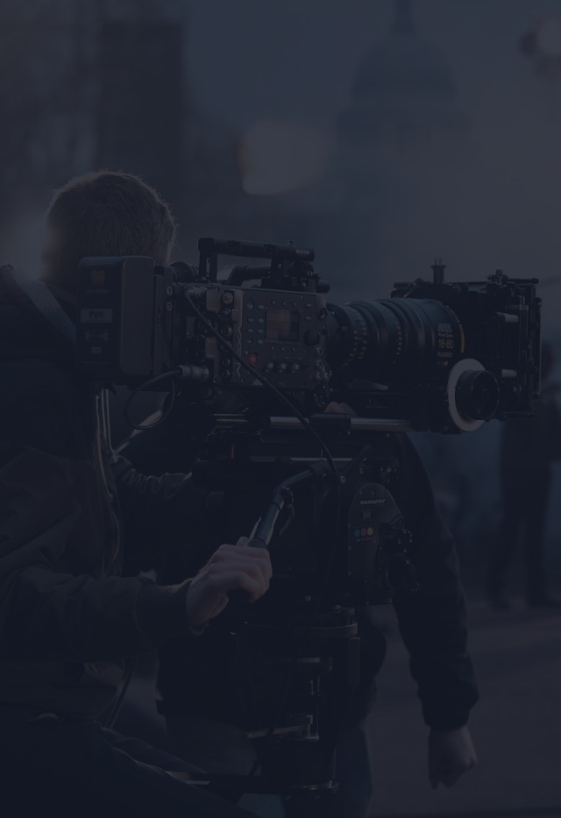
To use this brief template,
click File > Make a Copy
TEMPLATE
CREATIVE
BRIEF
Project Name – Finish Line Co. Newsletter 2
Client company – Finish Line Co.
Point Person – McKenna Manfull
Client Email – mckennamanfull@finishline.com
Client Phone – (956) – 791-8296

Slide 2
NEWSLETTER #1 CREATIVE BRIEF
1. OVERVIEW
Finish Line Co is expanding its messaging beyond students to reach parents of college students. This campaign introduces the Study Survival Kit as a thoughtful, practical way for parents to support their child during high-stress academic periods. Parents want their students to succeed but may not always know how to help from a distance. This newsletter positions the product as a supportive, affordable care package solution.
2. OBJECTIVES
TANGIBLE GOAL #1
Increase parent awareness of Deadline Fuel Co. as a student support brand.
TANGIBLE GOAL #2
Encourage parents to purchase a Study Survival Kit as a midterm or finals care package.
TANGIBLE GOAL #3
Establish brand credibility and trust with an older demographic.
3. TARGET AUDIENCE
Primary Audience: Parents of college students (ages 40–55).
Demographics:
Middle-income households
Value education and academic success
May live far from their student
Financial decision-makers
Key Insight:
Parents want to support their child’s academic success but need convenient, thoughtful solutions.
4. COMPETITION
Finish Line Co. competes with traditional care packages, Amazon snack bundles, sending money directly and local grocery deliveries. Finish Line Co. stands out by combining practical study tools with wellness focused snacks in one simple kit.
5. MESSAGE
You can’t take their exams for them, but you can support them in a meaningful way.
6. TONE
The tone of the news article is reassuring, supportive, professional, warm, and trustworthy. We want the parents to connect emotionally in support to their children in college.

Slide 3
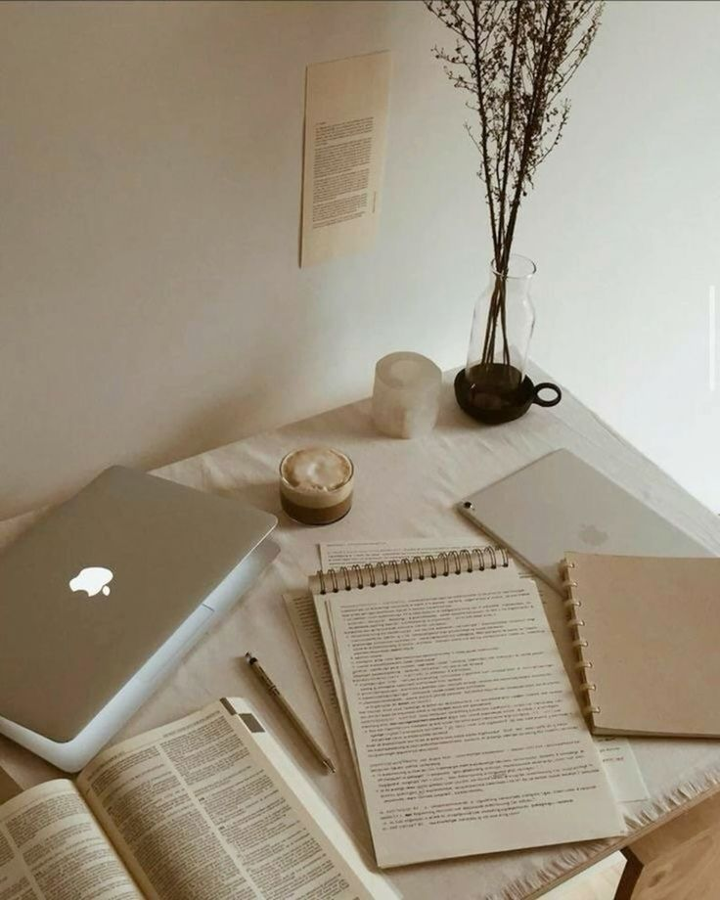
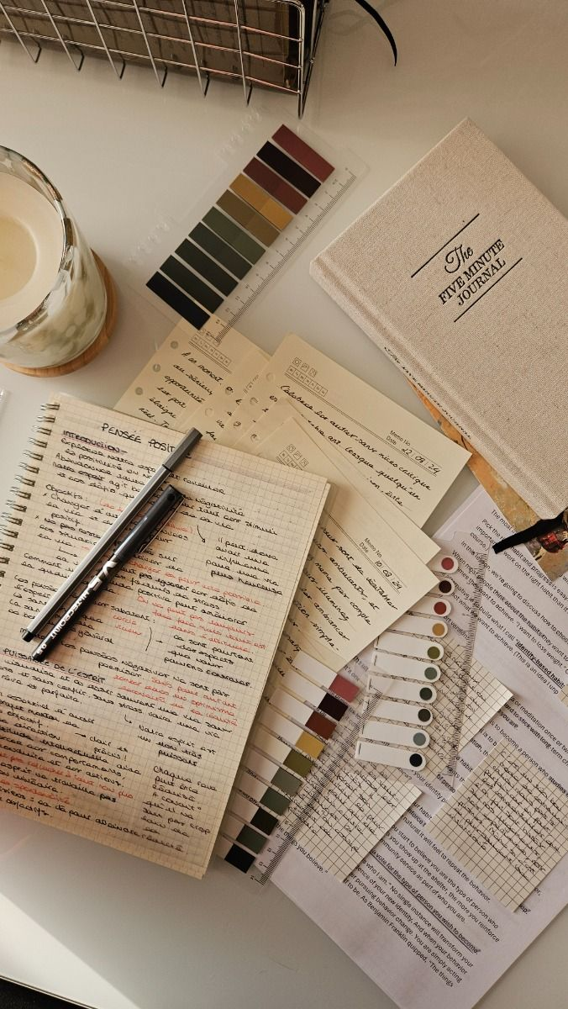


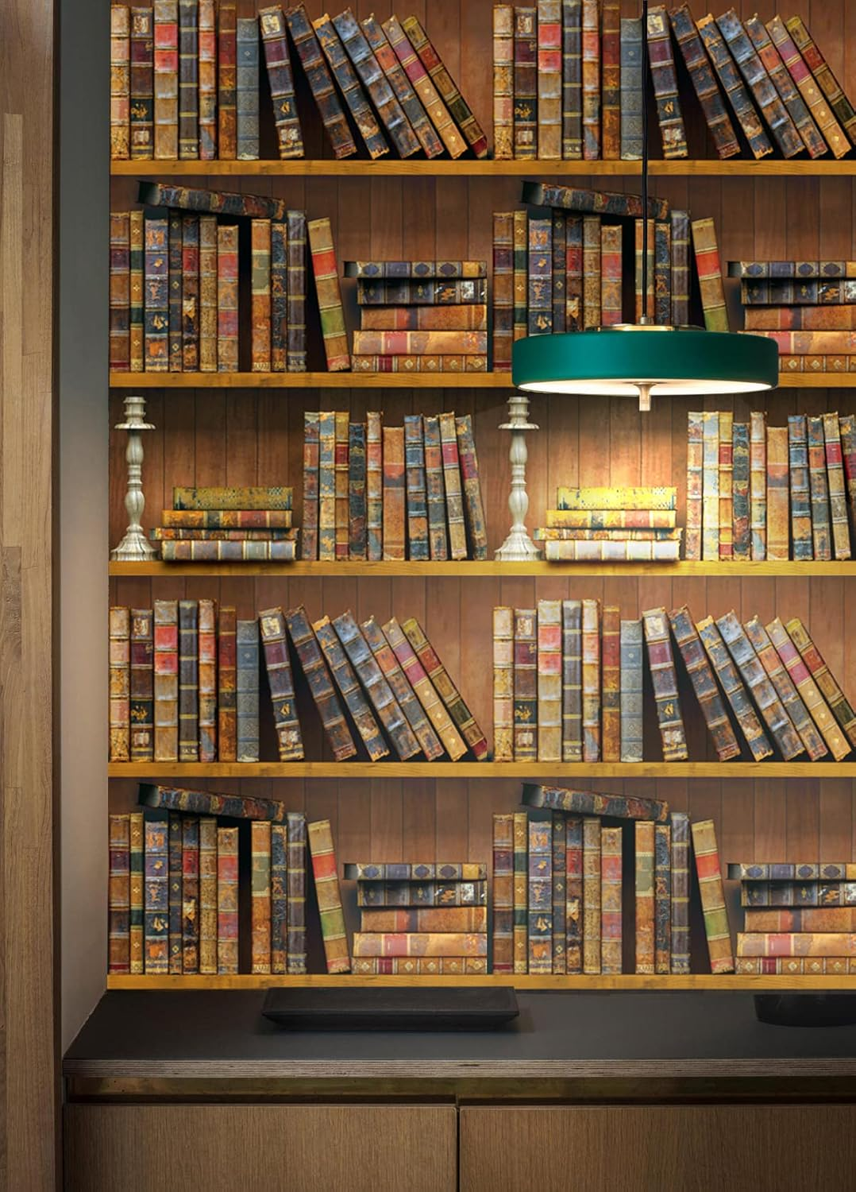
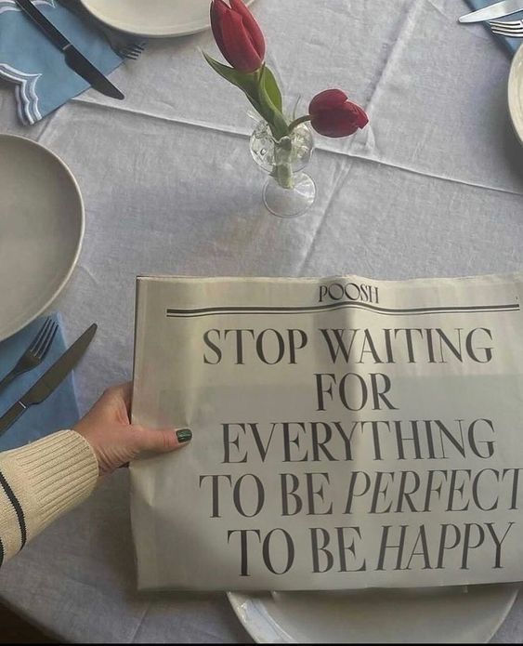
NEWSLETTER #1 CREATIVE BRIEF
7. VISUALS
The visuals are a clean modern layout with school themed graphics. It needs to be bright but not overwhelming with a lot of colors. Photos of students studying and clear call-to-action buttons. The overall aesthetic should feel trendy and student friendly, but also speak to the audience of their parents. The newsletter visuals don’t need to change because they speak to the audience.

Slide 4

NEWSLETTER #2 CREATIVE BRIEF
8. SCHEDULING
We will use the same scheduling for this newsletter. The first week we will brainstorm and draft the newsletter. The second week will be for revision content and finalize the design. The third week will be for launching and distributing. Some obstacles that we might face are students ignoring the emails, competing announcements of other academics, and limited marketing budget.
9. BUDGET
Estimated Budget: $500
Major Costs:
Graphic design software or templates
Promotional discount (15% off)
Digital advertising or campus promotion
Cost-Saving Options:
Use free design tools (Canva)
Promote through organic social media
Use email marketing platforms with student discounts
10. DATES & DEADLINES
PRE-PRODUCTION
First Script Draft 3-4
Revised Script 3-5
New Budget $500
PRODUCTION
Stage 1 Finialize Draft
Stage 2 Finialize Letter
POST-PRODUCTION
Deliver First Copy 3-9
Deliver Final Copy 3-12
DISTRIBUTION
Promote 3-13
11. STRAY OBSERVATIONS
Because the audience is parents, the messaging must prioritize trust, reassurance, and clarity over humor. Parents are more cautious when it comes to making decisions. They require stronger justification for purchases. Timing the campaign around midterms and finals will increase relevance and engagement. The overall tone needs remain warm, supportive, and professional to build credibility.
This creative brief template is brought to you by StudioBinder, the project management tool for video creatives.
Learn about more resources here: https://www.studiobinder.com/blog/

