Slide 1
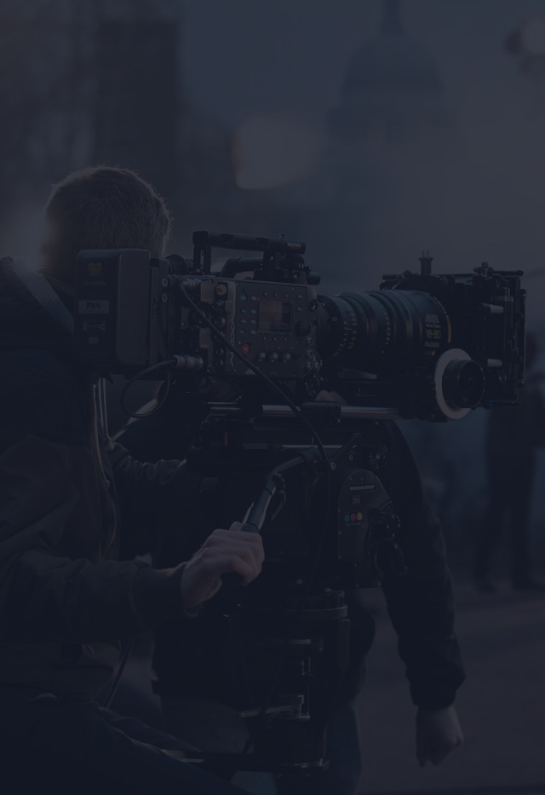
To use this brief template,
click File > Make a Copy
TEMPLATE
CREATIVE
BRIEF
Project Name – Finish Line Co. Newsletter
Client company – Finish Line Co.
Point Person – McKenna Manfull
Client Email – mckennamanfull@finishline.com
Client Phone – (956) – 791-8296

Slide 2
NEWSLETTER #1 CREATIVE BRIEF
1. OVERVIEW
Finish Line Co. is a focused towards students and created to help them stay productive, energized, and organized during busy academic weeks. This first newsletter will introduce the company, explain its purpose, and promote the “Study Survival Kit.” College students often feel overwhelmed during midterms and finals. The goal of this newsletter is to connect with students by acknowledging stress and offering a practical, affordable solutions to help get them through.
2. OBJECTIVES
TANGIBLE GOAL #1
Build awareness among college students through email engagement.
TANGIBLE GOAL #2
Encourage at least one-fourth of recipients to click and learn more about the Study Survival Kit.
TANGIBLE GOAL #3
Generate sign-ups for those one-fourth of students and offer discount for first-time purchases.
3. TARGET AUDIENCE
Primary Audience: College students (ages 18–24).
Demographics:
Age: 18–24
Gender: All genders
Income Level: Limited disposable income
Education Level: Undergraduate students
Key Insight:
Students experience high stress during exams and deadlines but want affordable, convenient solutions to stay productive.
4. COMPETITION
Finish Line Co. competes with: Energy drink brands (Red Bull, Monster), coffee shops (Starbucks, Dunkin’), productivity apps (Notion, Quizlet), and generic snack subscription boxes. The marketplace is crowded, but few brands specifically combine productivity tools and snacks tailored to college students at an affordable price point.
5. MESSAGE
The core message is, you don’t have to survive college alone; Finish Line Co. gives you the tools to power through deadlines without burnout. The theme is support, productivity, and student success.
6. TONE
The tone of the news article is relatable, energetic, encouraging, light humor, supportive, and understanding. The newsletter should feel like it was written by a student, not a corporation.

Slide 3
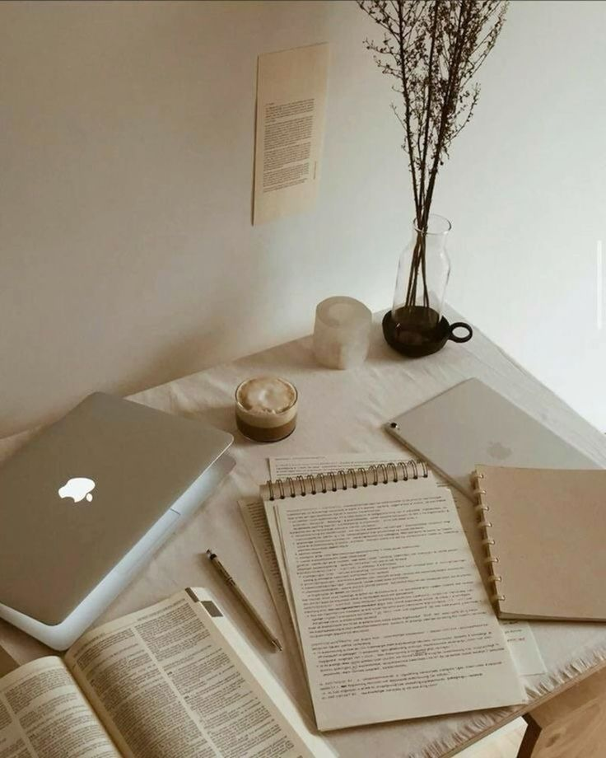
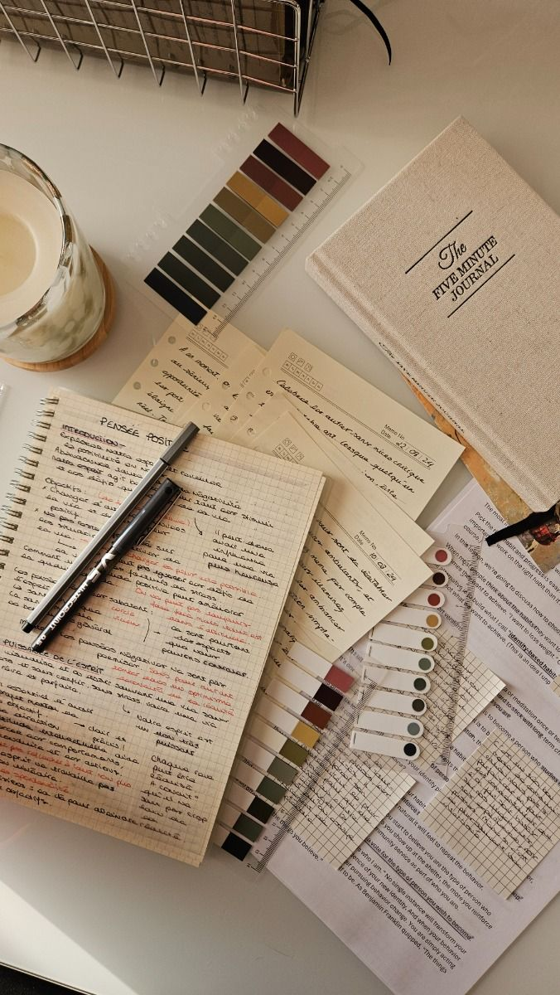
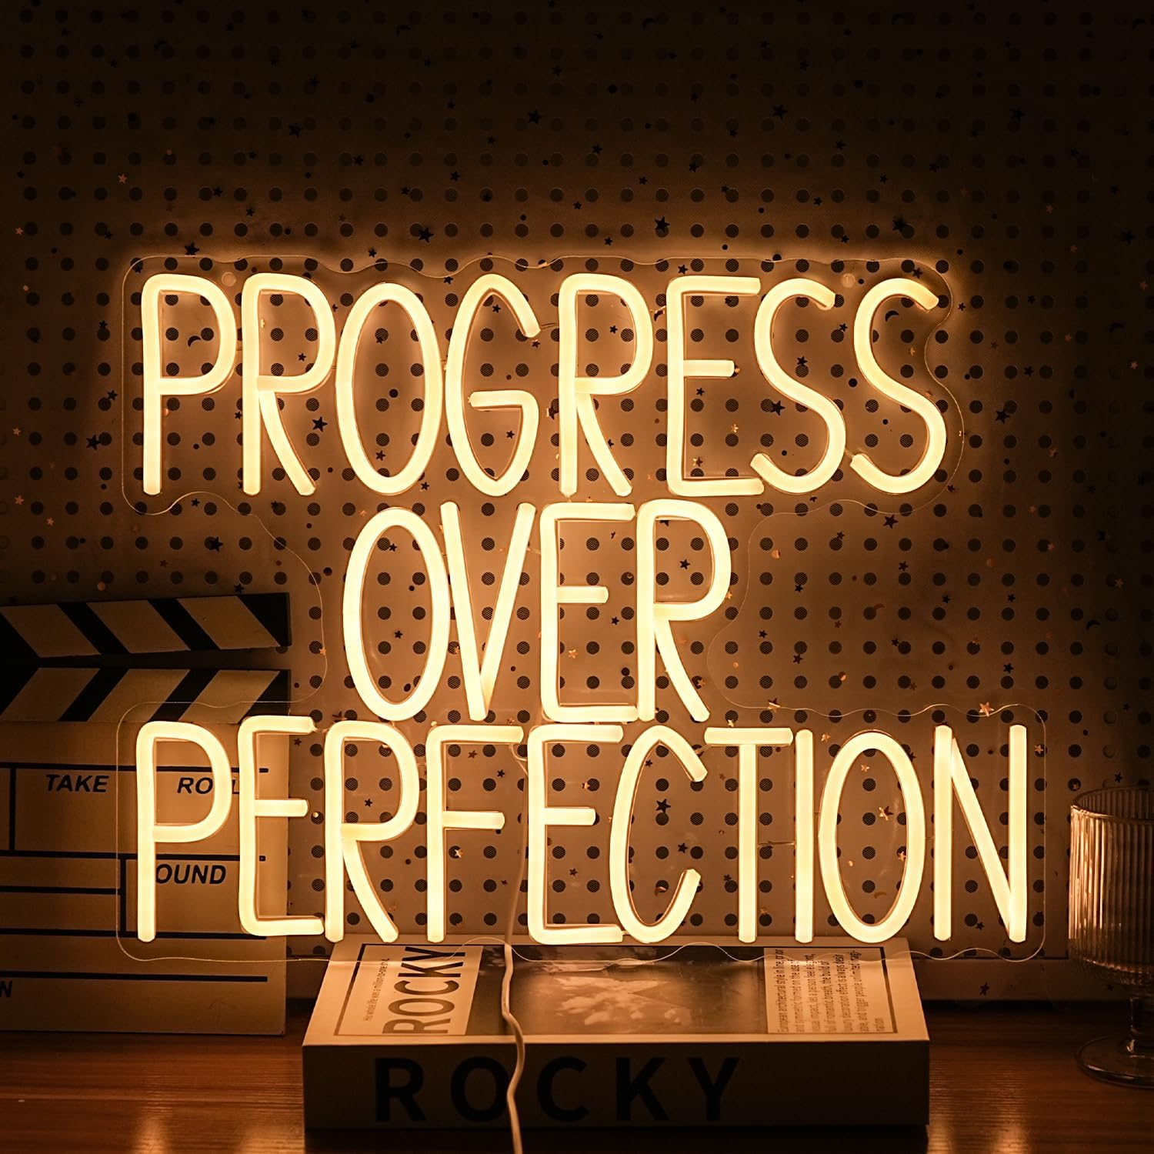
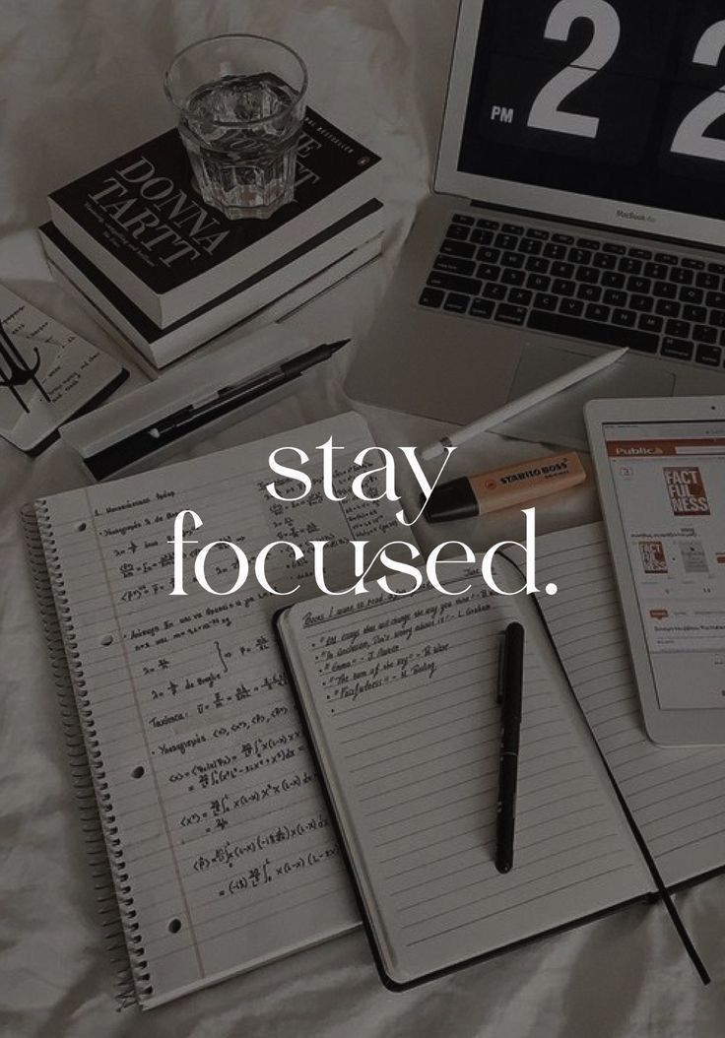
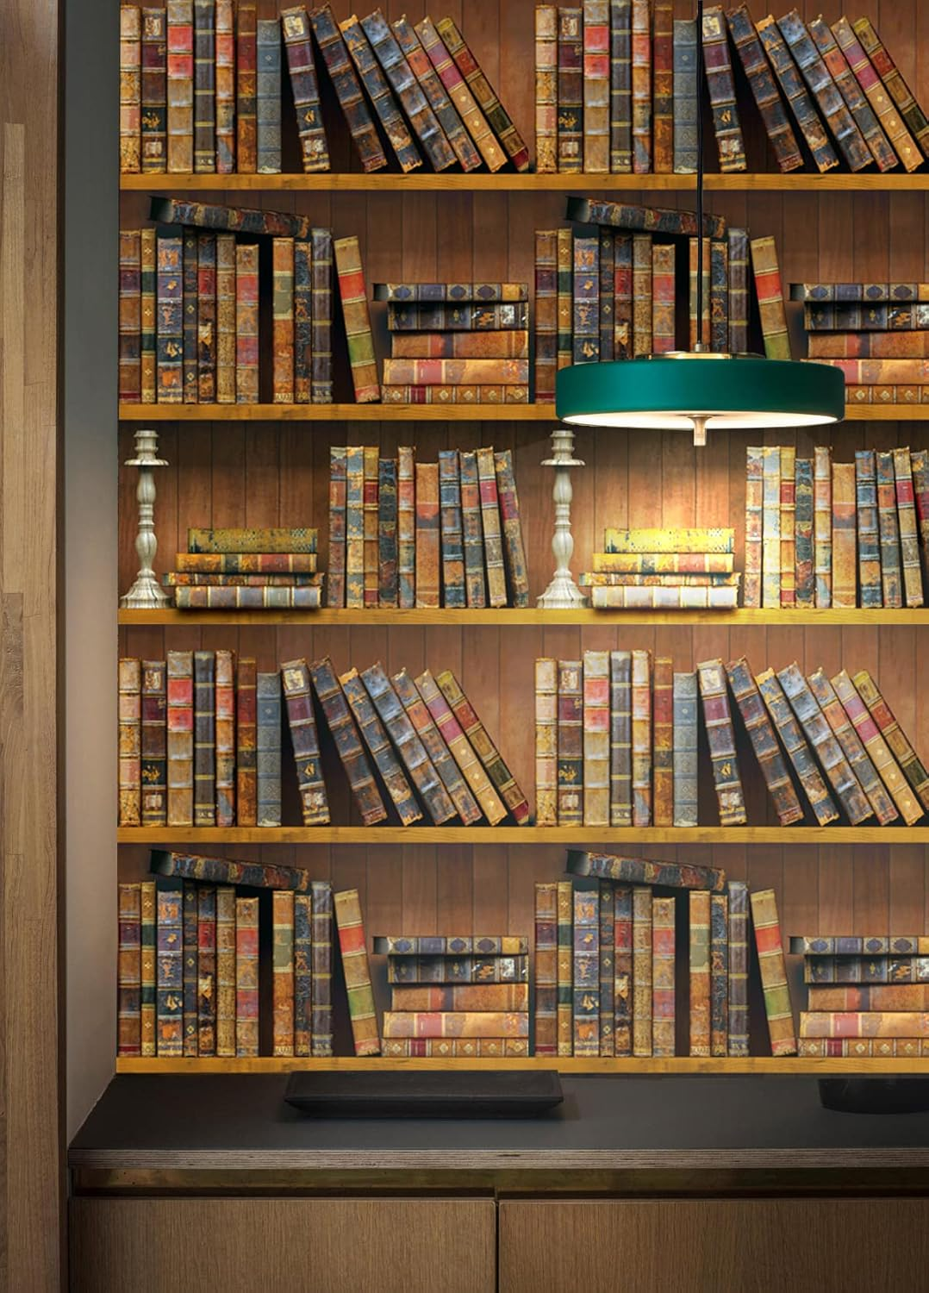
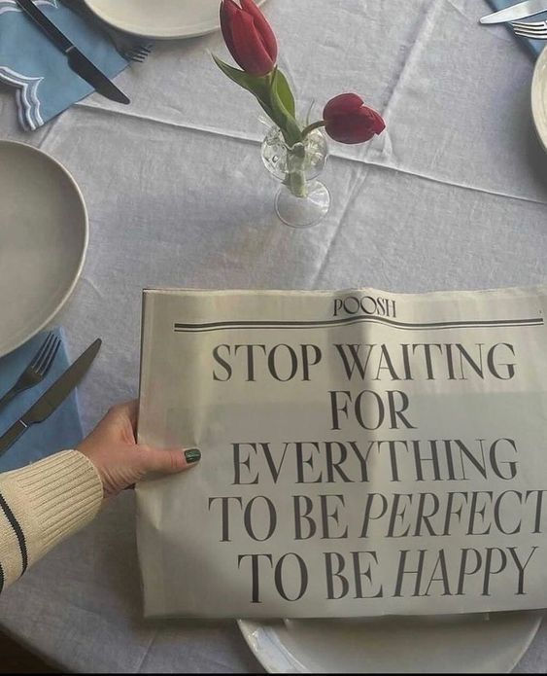
NEWSLETTER #1 CREATIVE BRIEF
7. VISUALS
The visuals are a clean modern layout with school themed graphics. It needs to be bright but not overwhelming with a lot of colors. Photos of students studying and clear call-to-action buttons. The overall aesthetic should feel trendy and student friendly.

Slide 4

NEWSLETTER #1 CREATIVE BRIEF
8. SCHEDULING
The first week we will brainstorm and draft the newsletter. The second week will be for revision content and finalize the design. The third week will be for launching and distributing. Some obstacles that we might face are students ignoring the emails, competing announcements of other academics, and limited marketing budget.
9. BUDGET
Estimated Budget: $500
Major Costs:
Graphic design software or templates
Promotional discount (15% off)
Digital advertising or campus promotion
Cost-Saving Options:
Use free design tools (Canva)
Promote through organic social media
Use email marketing platforms with student discounts
10. DATES & DEADLINES
PRE-PRODUCTION
First Script Draft 2-12
Revised Script 2-14
New Budget $500
PRODUCTION
Stage 1 Finialize Draft
Stage 2 Finialize Letter
POST-PRODUCTION
Deliver First Copy 2-16
Deliver Final Copy 2-17
DISTRIBUTION
Promote 2-18
11. STRAY OBSERVATIONS
Because the target audience is classmates, relatability is critical. The more authentic the voice feels, the more likely students are to engage. The newsletter should avoid sounding overly corporate and instead focus on real student struggles and solutions.
This creative brief template is brought to you by StudioBinder, the project management tool for video creatives.
Learn about more resources here: https://www.studiobinder.com/blog/

